Slide 1
Game Name: Seared
Story summary:
Throughout their life, Ash worked in the Company's grasp, but one thing they did not have a grasp on was Ash's will. Or the time travel technology they tried to hide from the world.
Follow Ash through the past and future. Find "humanity's" past, how they developed the present, and prevent the future the Company - named Seared - seeks to create.
To uncover the secrets of the past, you'll need the future to find your way, switching between the two in an immersive 2D puzzle platformer, as rich as the society before their own...
Heavily inspired by the Effect and Cause level from Titanfall 2, presented in a 2D puzzle platformer. “Shifting” between past and future will be the main mechanic of the game, focusing on puzzle gameplay between worlds to progress through levels, explore the past, and uncover what the future may hold.
Gameplay mechanics will include:
“Shifting” between times to forge the way forwards
Pushing blocks (onto pressure plates)
Activating buttons/levers
Grabbing and using keys to unlock doors (up to 3 at a time)
Basic combat later into the game

Slide 2
Lore
Lore Backstory
Inspiration from: Hollow Knight, Journey, Lone series
Main plot: climate change and renewable energies. Dystopian future and travelling through the castle like history.
History links. (Nuclear) Ice age. Replanting trees. The switch from wood to coal.
Intent to sort out environmental struggle.
Travel through their history for answers.
Works of their own accord: stole the time travel device and is now against the Company.
Company plans for nuclear energies to be developed. We all know how that went: Chernobyl, threat of nuclear fallout etc.
MC wants to stop that
Heard stories/read books on renewable energy and benefits. Can be hinted at in game but doesn't necessarily need to be there.
Dystopian future!
Switches between times to access the past and their "secrets". Doesn't need to be explicitly shown especially at the start but will build with lore: how the past developed into the future.
Fix the problem, cus the Company sure won't.
Nuclear Ice Age implied ending?
World history
Past:
Mundane/a little more idealised.
Medieval style (or just an older time to fossil fuels).
Wood primarily → slow switch to coal.
Replant trees and use them sparingly.
Paganism could play a part like a belief in a higher God like being(s) to look over them. Sort of like a Gaia/Terraria/God of the Earth.
Switch to coal imaged as a gift at the beginning, but slowly turns evil. [Miasma idea, smoke, earlier deaths etc.] Probably won't be implemented cus that would be further into the story.
Plans for further bioenergies to be produced and spread. Scrapped for an influx in coal usage. Again further into the story.
Future:
No visible or evident renewable energy.
Cave could show scrapped renewable energy plans alongside blueprints for other projects like transport, or main base of operations for the Company's secrets.
No religious beliefs, no Gods, just "progress".
Broken TV broadcasts could show these or as said blueprints laid over each other.
Like the murals of old, just twisted for profit.
Fossil fuels, smoke, [warm orange for sun and moon} ONLY IF NECESSARY.
Transport influx: cars, locomotives, steam, fire, nuclear.
Fire imagery will play a part in the "futuristic" aesthetic.
Everything left in the dust - landfill.
Industrial De-evolution.
Atmosphere
Past:
Water, Natural
Colder colours
Reminiscent of water
Life clearly thriving
Plentiful water
Flowing river and foliage
Lack of coal. For now.
Horses and carts. "Primitive" transport
Manure used for crops - natural usage
Thriving land - greens
Farming evident if possible
Water dripping in cave
All natural stones for buildings - castle
Carvings and tapestries
Well aired - wind effects if possible
Clean and taken care of unlike the future. NURTURED.
Natural light in the castle made intentionally for light to get in
If NPCs: thriving
Future:
Fire, Industrial
Warm colours
Hot orange for sun and moon, again only if needed
Smoky. Embers if possible
Dead trees → Mural of conservationalist on a dead tree
Lack of water flow
Dark and gloomy
Dark looming clouds or no clouds at all
Images of past transport: locomotives, steam engines etc. Could be in landfill and blueprints
Dark and dusty, dry - absolutely needed for the castle and the cave
Sort of industrial but a little more advanced
Radioactive greens? Further into the forest/cave area.
Torn tapestries and collapsed carvings
Natural light due to destruction of the past
If NPCs: depression
Devastation and contrast between past and future becomes more evident in the forest areas.
Lore
Lore Backstory
Inspiration from: Hollow Knight, Journey, Lone series
Main plot: climate change and renewable energies. Dystopian future and travelling through the castle like history.
History links. (Nuclear) Ice age. Replanting trees. The switch from wood to coal.
Intent to sort out environmental struggle.
Travel through their history for answers.
Works of their own accord: stole the time travel device and is now against the Company.
Company plans for nuclear energies to be developed. We all know how that went: Chernobyl, threat of nuclear fallout etc.
MC wants to stop that
Heard stories/read books on renewable energy and benefits. Can be hinted at in game but doesn't necessarily need to be there.
Dystopian future!
Switches between times to access the past and their "secrets". Doesn't need to be explicitly shown especially at the start but will build with lore: how the past developed into the future.
Fix the problem, cus the Company sure won't.
Nuclear Ice Age implied ending?
World history
Past:
Mundane/a little more idealised.
Medieval style (or just an older time to fossil fuels).
Wood primarily → slow switch to coal.
Replant trees and use them sparingly.
Paganism could play a part like a belief in a higher God like being(s) to look over them. Sort of like a Gaia/Terraria/God of the Earth.
Switch to coal imaged as a gift at the beginning, but slowly turns evil. [Miasma idea, smoke, earlier deaths etc.] Probably won't be implemented: would be further into the story.
Plans for further bioenergies to be produced and spread. Scrapped for an influx in coal usage. Again further into the story.
Future:
No visible or evident renewable energy.
Cave could show scrapped renewable energy plans alongside blueprints for other projects like transport, or main base of operations for the Company's secrets.
No religious beliefs, no Gods, just "progress".
Broken TV broadcasts could show these or as said blueprints laid over each other.
Like the murals of old, just twisted for profit.
Fossil fuels, smoke, [warm orange for sun and moon} ONLY IF NECESSARY.
Transport influx: cars, locomotives, steam, fire, nuclear.
Fire imagery will play a part in the "futuristic" aesthetic.
Everything left in the dust - landfill.
Industrial De-evolution.

Slide 3
Atmosphere
Past:
Water, Natural
Colder colours
Reminiscent of water
Life clearly thriving
Plentiful water
Flowing river and foliage
Lack of coal. For now.
Horses and carts. "Primitive" transport
Manure used for crops - natural usage
Thriving land - greens
Farming evident if possible
Water dripping in cave
All natural stones for buildings - castle
Carvings and tapestries
Well aired - wind effects if possible
Clean and taken care of unlike the future. NURTURED.
Natural light in the castle made intentionally for light to get in
If NPCs: thriving
Future:
Fire, Industrial
Warm colours
Hot orange for sun and moon, again only if needed
Smoky. Embers if possible
Dead trees → Mural of conservationalist on a dead tree
Lack of water flow
Dark and gloomy
Dark looming clouds or no clouds at all
Images of past transport: locomotives, steam engines etc. Could be in landfill and blueprints
Dark and dusty, dry - absolutely needed for the castle and the cave
Sort of industrial but a little more advanced
Radioactive greens? Further into the forest/cave area.
Torn tapestries and collapsed carvings
Natural light due to destruction of the past
If NPCs: depression
Devastation and contrast between past and future becomes more evident in the forest areas.

Slide 4
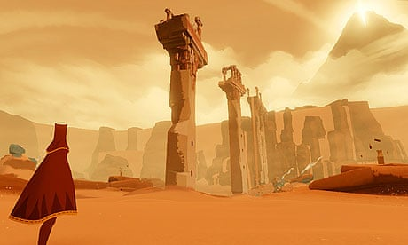
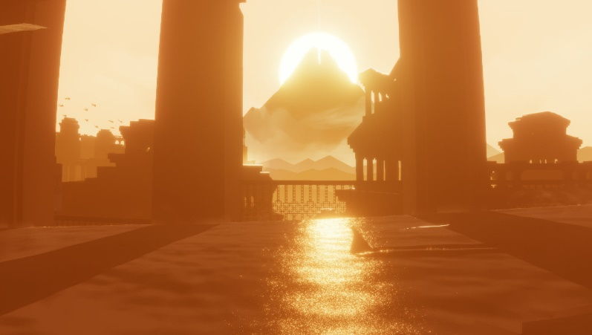
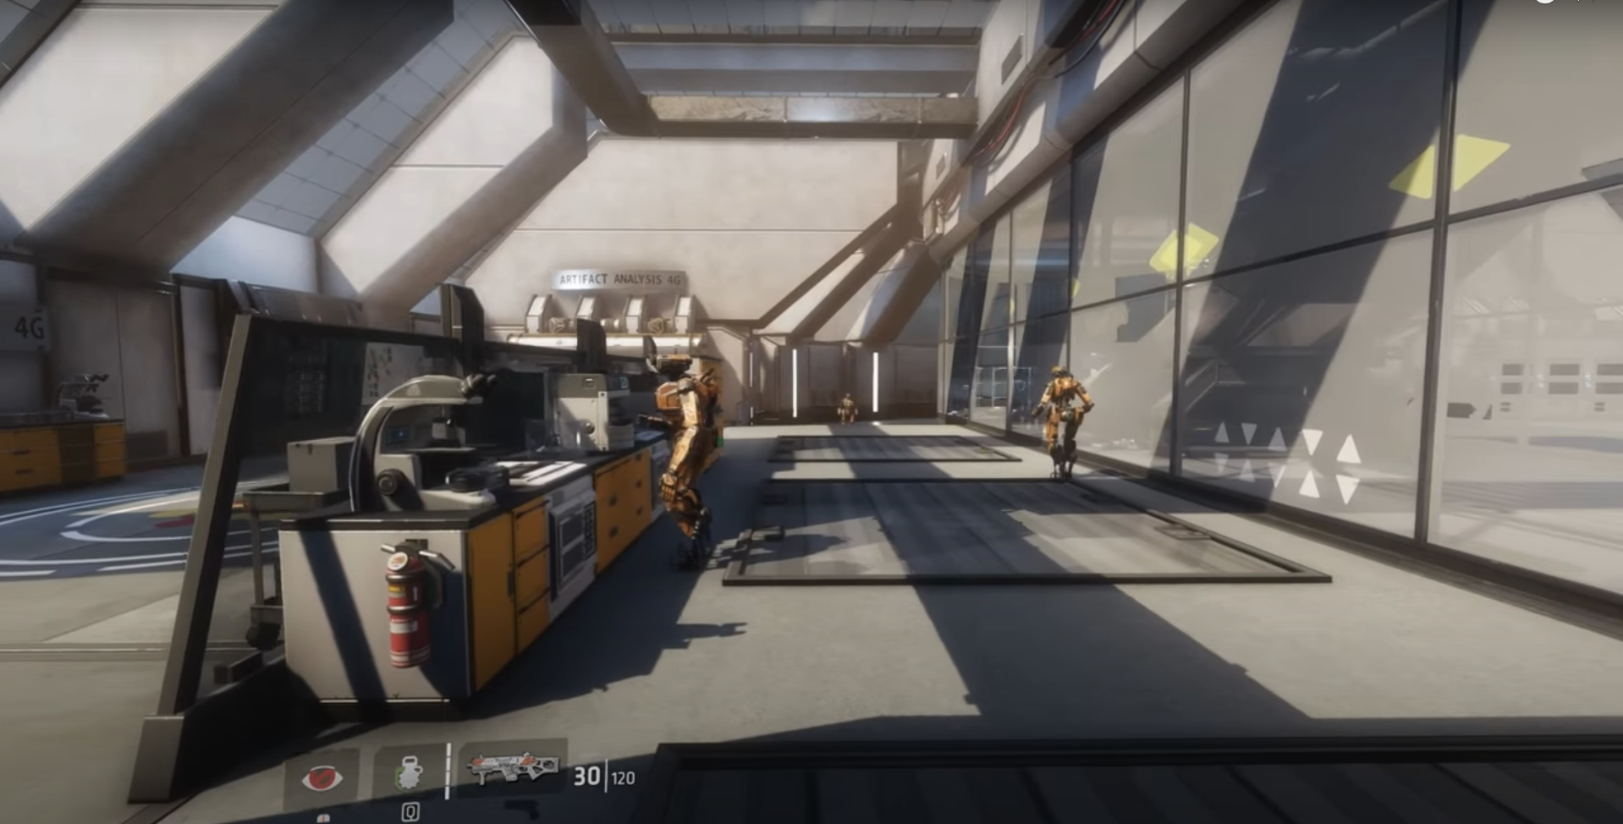
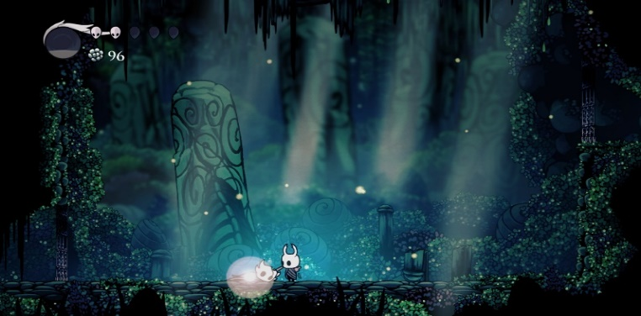
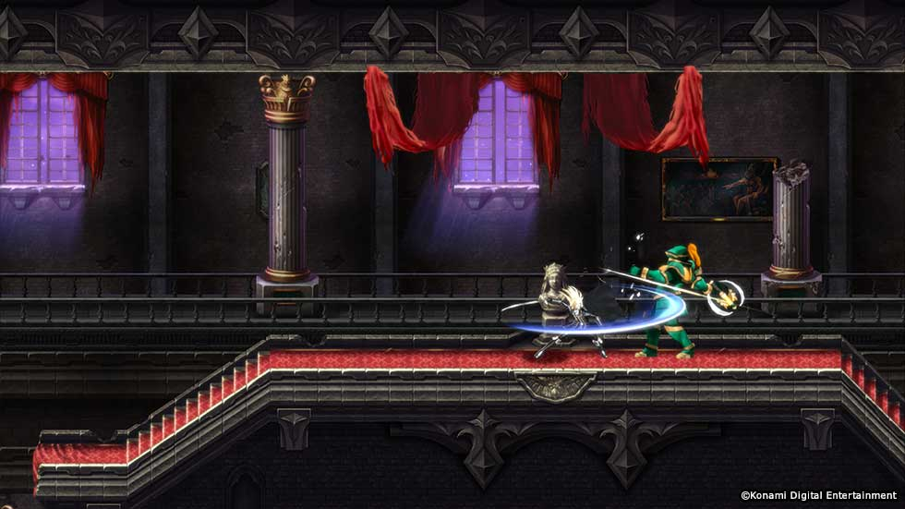
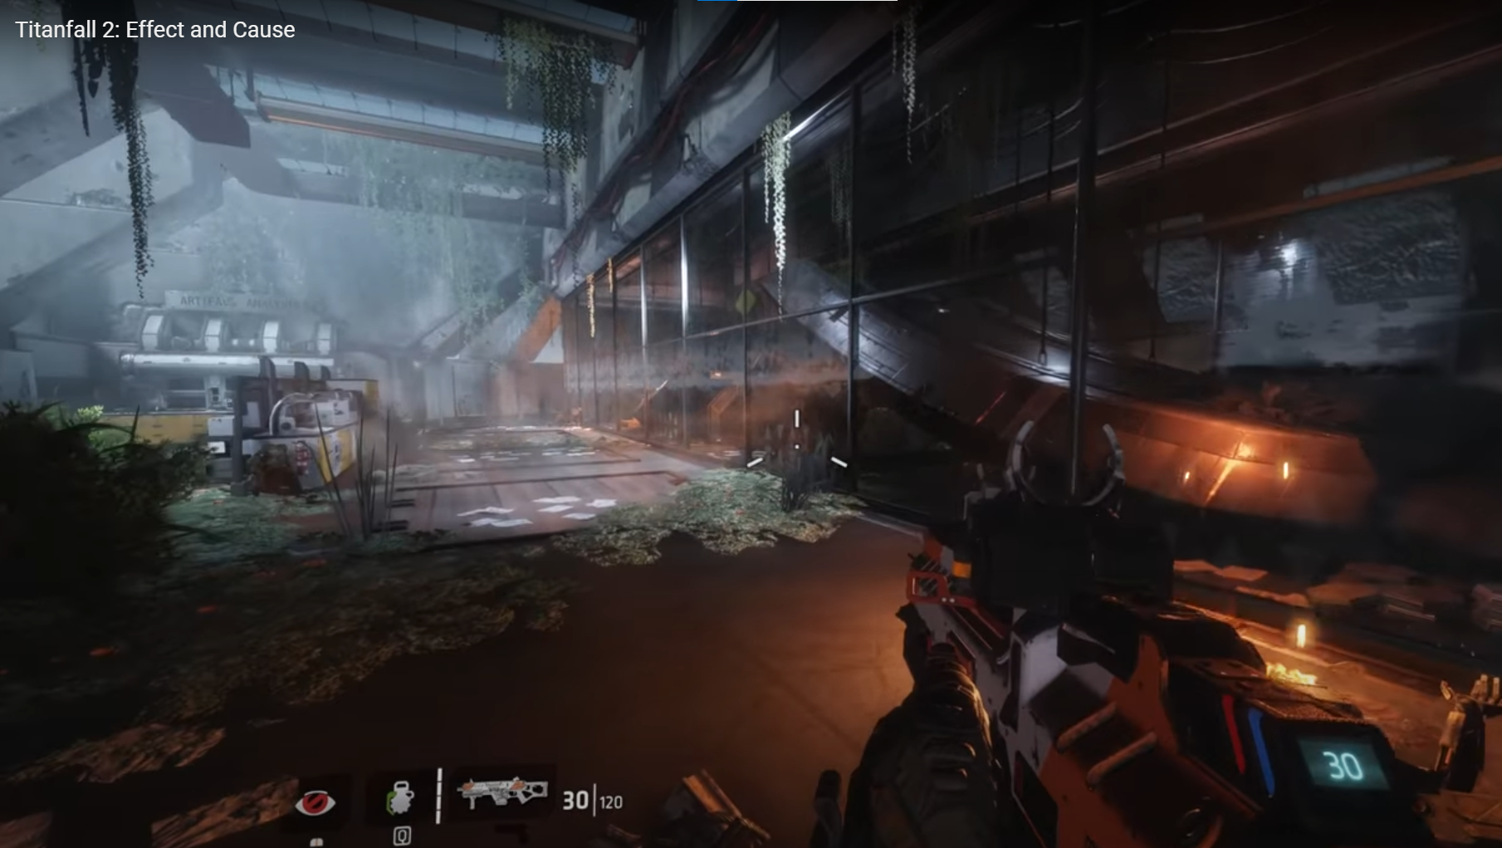
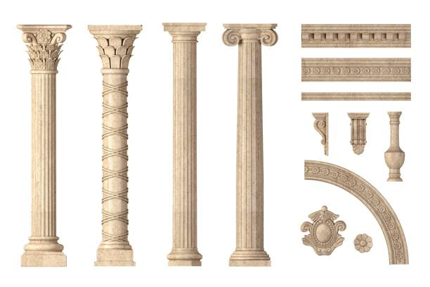
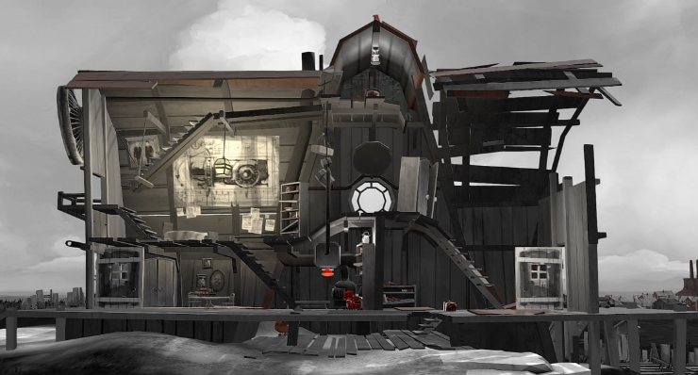
Visual inspiration Mood Board & Game Comparisons

Slide 5




Character Concept
Past version:
Horns are softer and rounder to emphasise a softer disposition. It is unclear why or how this change was made when the shifts occur, but reflects the past: a softer look for a softer time.
Future version:
The horns of Ash are sharper, more “untamed” and dangerous in comparison to their past version, demonstrating a lack of care for themselves. It also reflects the Company they used to work under: Seared. Their dangerous and unfiltered plans reflect in their dispositions, appearing wild, jagged and frankly, untrustworthy.

Slide 6
Heavily inspired by the Effect and Cause level from Titanfall 2, presented in a 2D puzzle platformer. “Shifting” between past and future will be the main mechanic of the game, focusing on puzzle gameplay between worlds to progress through levels, explore the past, and uncover what the future may hold.
Gameplay mechanics will include:
“Shifting” between times to forge the way forwards
Pushing blocks (onto pressure plates)
Activating buttons/levers
Grabbing and using keys to unlock doors (up to 3 at a time)
Basic combat later into the game

Slide 7
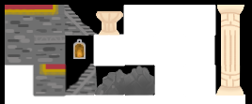
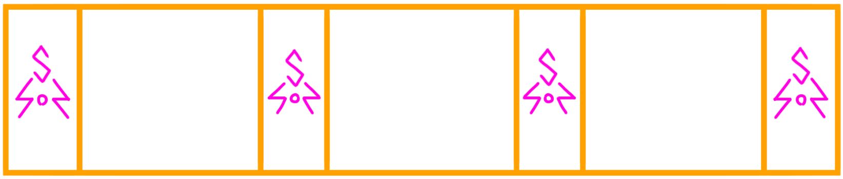
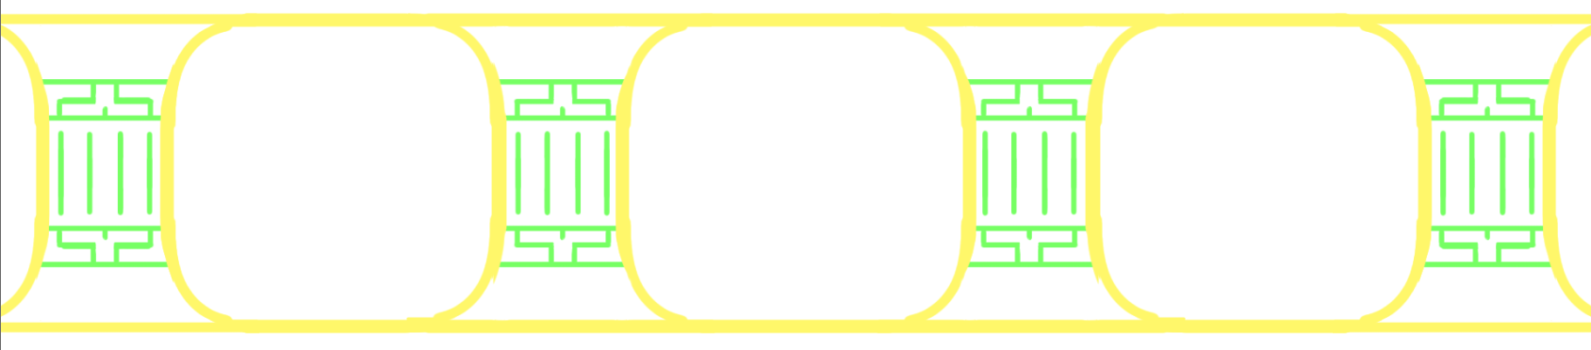
Environmental design/ other designs

